Slide 1
Chatbots Development with Machine Learning
Overview of Chatbots
Purpose of Chatbots
Types of Chatbots
Mechanism of Chatbots
Shahzaib Hamid
AI Sciences Instructor

Slide 2
Module Overview
Overview of Chatbots
Need of Chatbots
Types of Chatbots
Mechanisms of Chatbots
History
Applications
Comparison
Benefits
Why You!
Rule Based
Self Learning
Architecture
Process
Challenges

Slide 3
Overview of Chatbots
History
1966
Eliza
1972
Parry
1995
A.L.I.C.E
2001
Smarter Child
2010
SIRI
2012
Google Now
2015
ALEXA
CORTANA
Recent Developments
Medical Bots

Slide 4
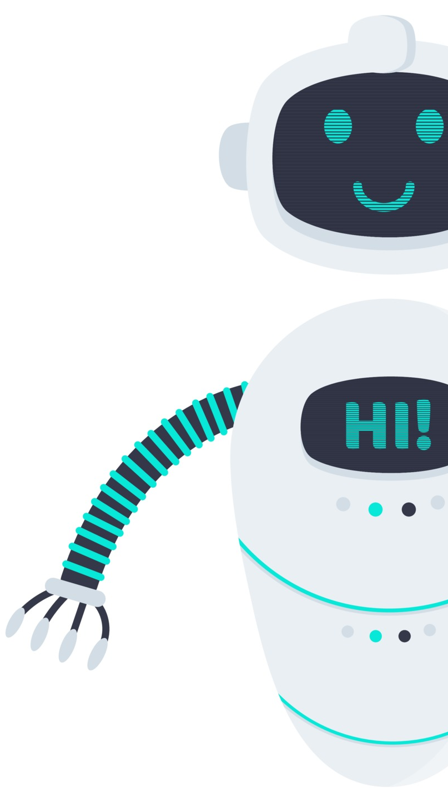
Overview of Chatbots
Applications
Help Desk Assistant
Tutor
Home Assistant
Office Assistant
Phone Assistant
Medical Assistant
Chatbots

Slide 5
Overview of Chatbots
Chatbots Vs. Virtual Assistants Vs. Personal Assistants
Chatbots
Single-Turn Operation User: Ok Google! What is AI Sciences
Virtual Assistant
Engages in Conversation Bot is Trained User: I am having panic attack, what should I do?
Personal Assistants
Exhibit its own unique personality Provide contextual answers as per user Improves over time User: Set a reminder for tomorrow's meeting with AI Consultant

Slide 6
Need of Chatbots
Benefits of Adopting Chatbots
Personalized Customer Experience
Efficient Staff Onboarding
Lead Identification
Standardized Solutions
Cost Saving
Scalability
24 / 7 Available

Slide 7
Need of Chatbots
Why a Company Should Adopt it!
Simple and Direct
Fast and Uninterrupted
Improved Experience
Increases Revenue
Personalised
Sustainable

Slide 8
Types of Chatbots
Classification
Rule Based Chatbots
Self Learning Chatbots

Slide 9
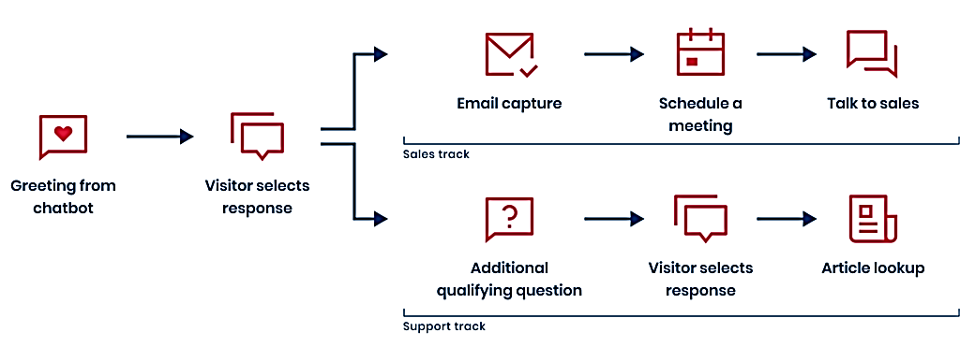
Types of Chatbots
Rule Based Chatbots

Slide 10
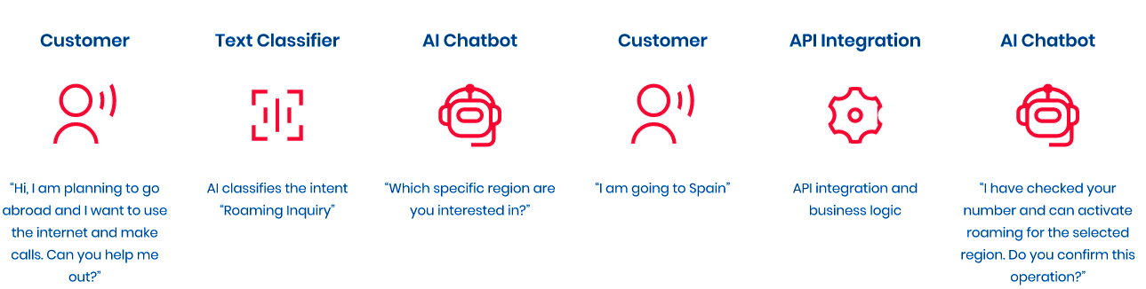
Types of Chatbots
Self Learning Chatbots

Slide 11
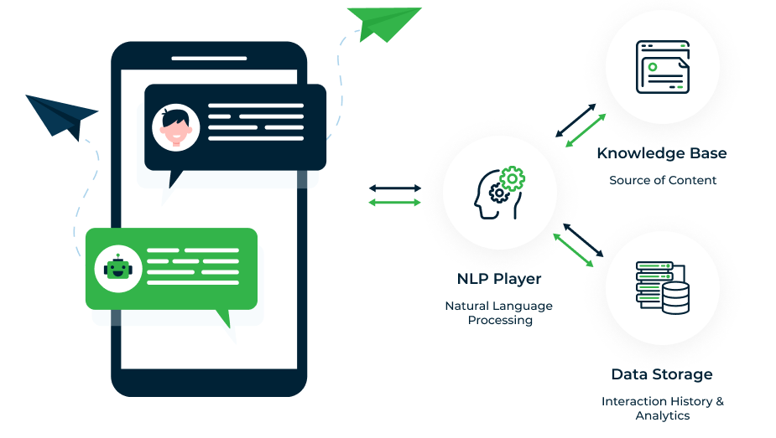
Mechanism of Chatbots
General Architecture

Slide 12
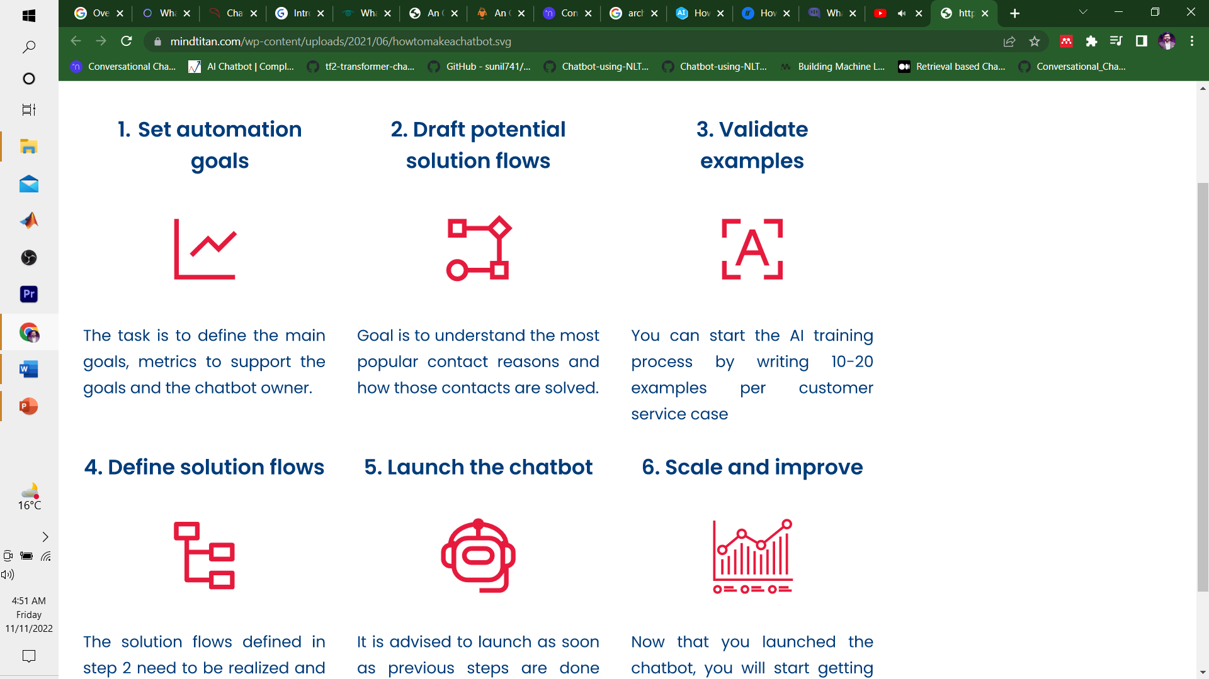
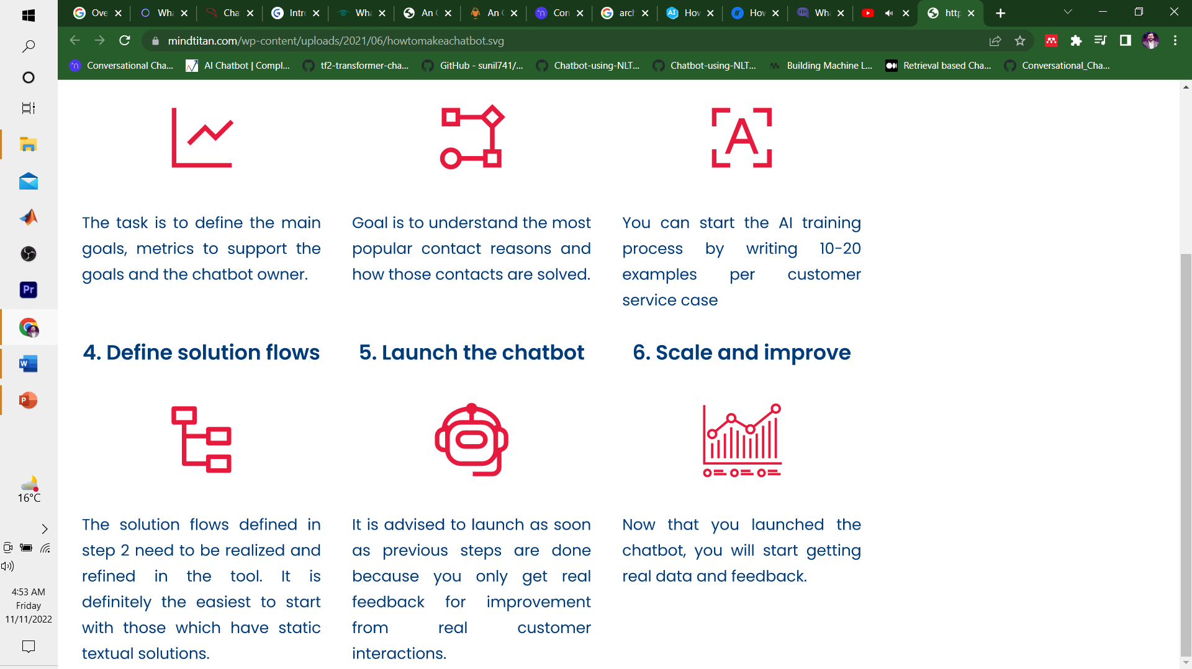
Mechanism of Chatbots
Process

Slide 13
Mechanism of Chatbots
Challenges
Emerging Trends
Security and Privacy
Customer Saturation
Unpredictable Human Behavior
User Satisfaction
User-Bot Communication
Challenges

